Slide 1
Sprint2 DATA BASE SERVER
Muskan Allabaksh Pathan​
Sri Harshita Talari​
Renuka Gujjala​
Bhagyalakshmi Daliparthi​
Sarika Pathiputturu​
Vinitha Devalla​

Slide 2
contents
Introduction
Application Solution
Work-Flow
Testing
Conclusion

Slide 3
Introduction
Database are used to store and manage data that are sent to the server .This server keeps the data in a format. It also allows users and applications to access the data across the network. A large databases used in every organization to store and protect data on client requests.
This application user TCP mechanism to connect User, Client and Server with each other.
Here the application store, modify or retrieve the data, based on the request of multiple clients to Server to store the data and retrieve the data from database.

Slide 4
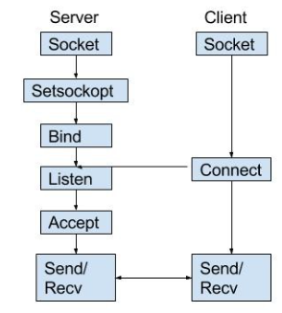
Application Solution
Socket Programming :
Socket programming is a way of connecting two nodes on a network to communicate with each other. One socket(node) listens on a particular port at an IP, while the other socket reaches out to the other to form a connection.

Slide 5
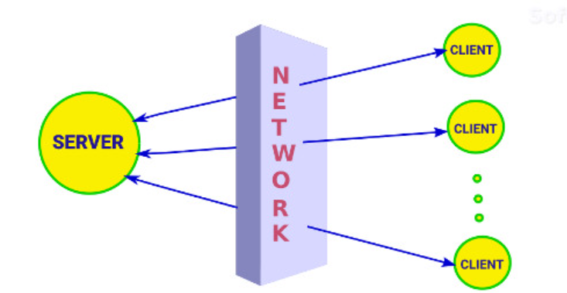
Multi-Threading :
Multi-threading refers to the use of many threads inside a single process.
Each thread serves a separate function.
It operates concurrently.
It can handle multiple request from multiple of clients.

Slide 6
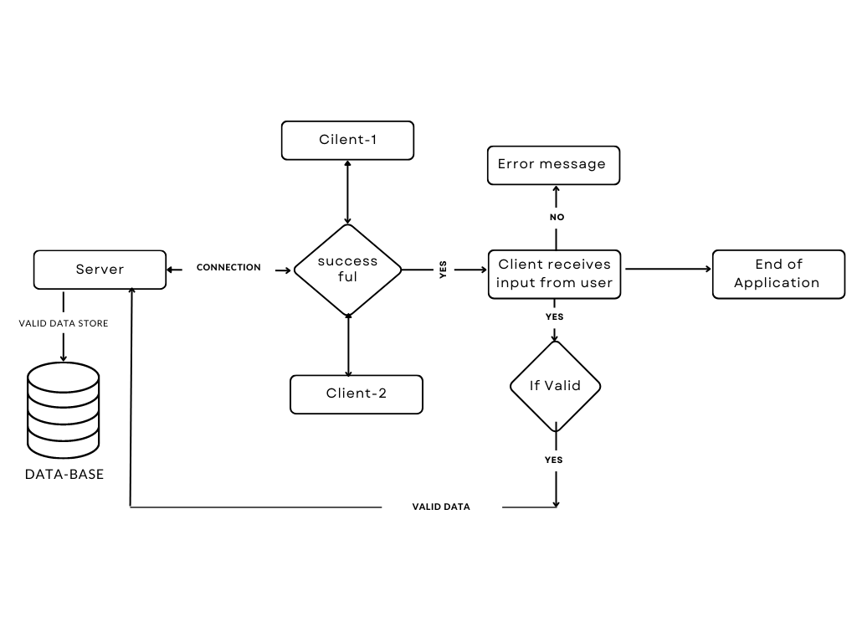
hld :

Slide 7
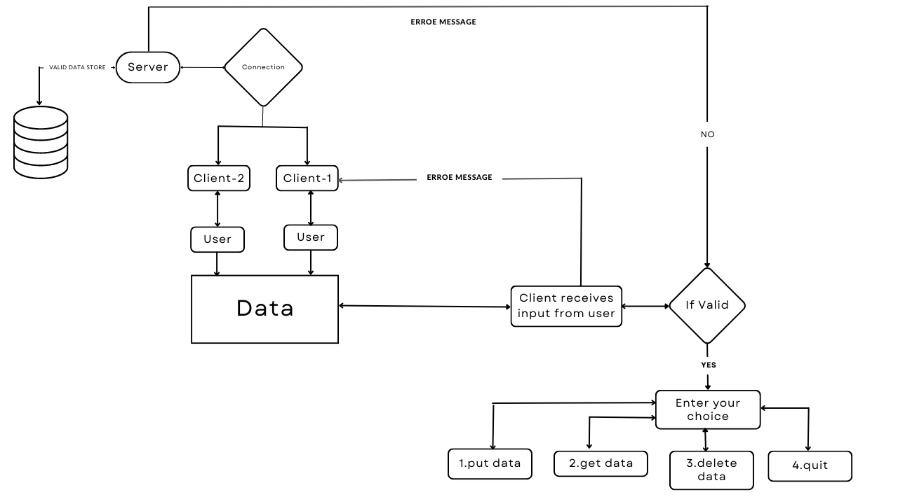
LLd

Slide 8
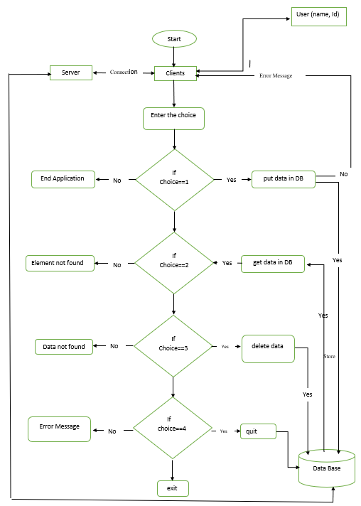
Flow chart :

Slide 9
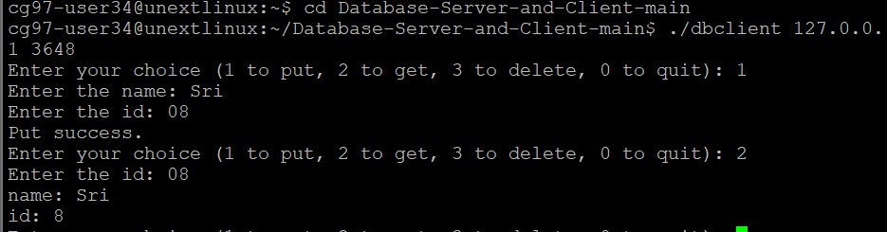
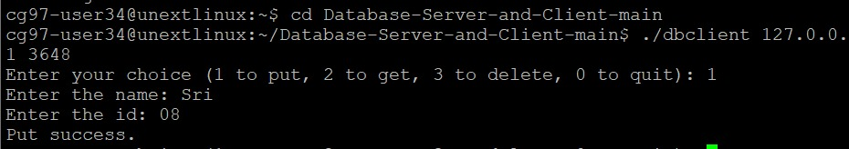
UT& IT case
User chooses option 1
PUT success
User chooses option 2
GET Success
User chooses option 3
DELETE Success

Slide 10
Client 1:Chooses option 3
Delete Success
Client 2: Chooses option 3
Delete Failed
Client 2: Chooses option 2
Get Failed

Slide 11
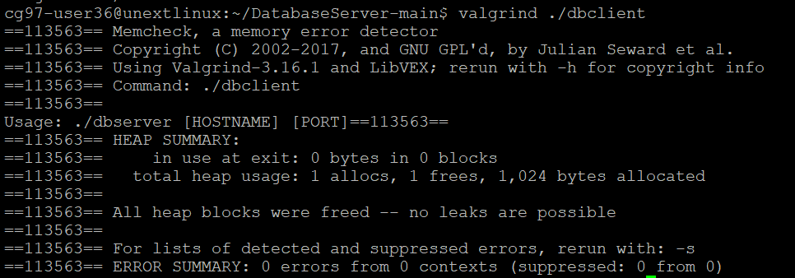
Valgrind test report

Slide 12
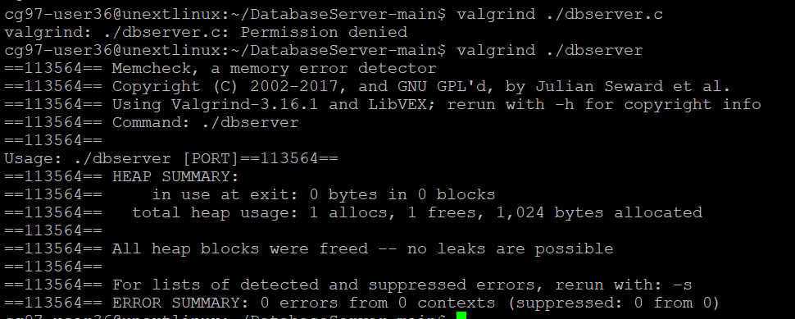

Slide 13
conclusion
Successfully launched and implemented the Database server application. This application is able perform operations based on user requirements and give expected results with more efficiency and less time.

Slide 14

THANK YOU

